Slide 1

Gamified Solutions in Healthcare game test in Sendai
15.5.2015 SNCT Hirose campus
M.Sc. Teppo Saarenpää

Slide 2
Gamified Solutions in Healthcare project

Slide 3



GSH in Nutshell
Focus: new services and effective activity solutions to elderly people through gamification
Objectives: offers more options for the elderly’s self care and eases the healthcare professional’s work load
Research Institutes: TUAS and University of Turku
Other partners: Tekes, Attendo Finland, Puuha Group, Serious Games Finland, City of Turku
International Cooperation: Singapore Polytechnic, Tohoku University, Sendai National College of Technology, Waseda University, Sendai Finland Wellbeing Center

Slide 4

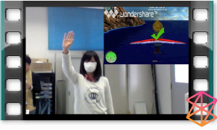
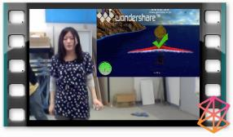

Background – Tests in Japan
Tests were at Prof. Hongo’s Lab in Sendai National College of Technology
Executed by Nakai san and assisted by Mr Kentaro Katahira and Mr Junnichi Yoshida
Totally 12 test subjects (6 female and 6 male students)
We were not able to receive any elderly subjects from FWBC
Results published in (Nakai et al., 2013)

Slide 5
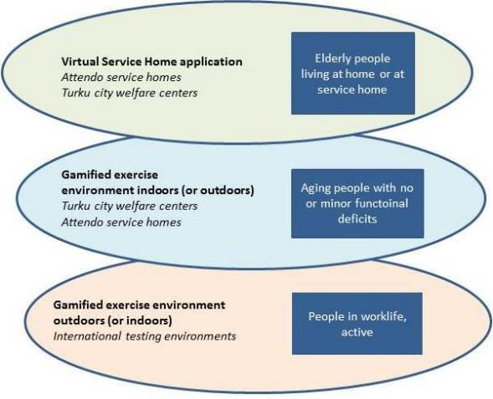


GSH Research Focus

Slide 6
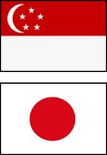
GSH - Social Functioning

Slide 7
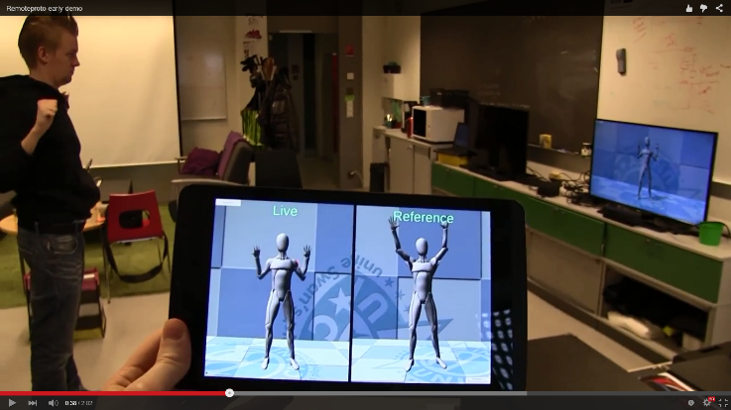

GSH - Virtual Physical Therapy

Slide 8

GSH - Rehabilitation Games
Modyfying existing SportWall game for Japanese elderly people

Slide 9


GSH – End User Experiences

Slide 10
Tests in Sendai

Slide 11
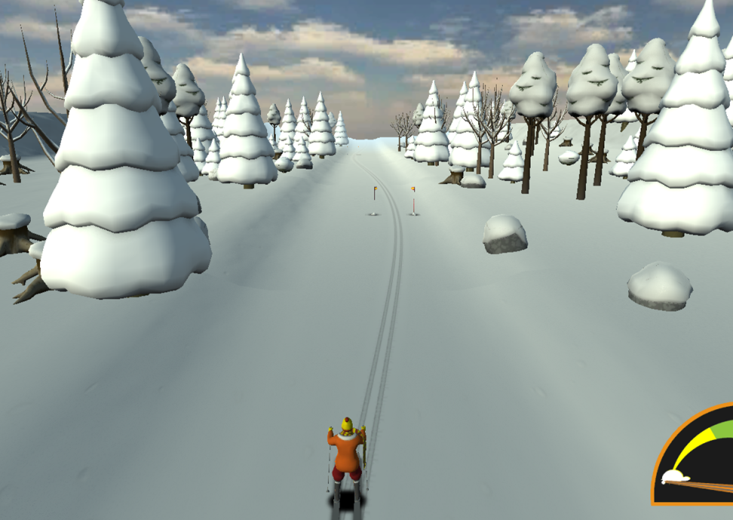
Skiing Game test targets
To find out whether this game is suitable for elderly persons (>65 years old)
To compare if tests results are different than ones in Finland
To get feedback on game features
To get new ideas for game development

Slide 12
Skiing Game field test schedule
11th May Preliminary meeting for questionnaires
13th May Preliminary meeting for simulation for FT (rental of LCD TV)
20th May an entire day Field test
21st May AM Field test (pick up LCD TV)
Start gathering applicants on 21st Apr.

Slide 13
被験者
65歳以上の方
一般的に健康の方
5分以上起立していられる方
ゲームを体験しアンケートに回答
ゲーム体験中にビデオ撮影有
20th | Time schedule | Examinees
 | 10:00 – 10:45 | 2
 | 10:30 – 11:15 | 2
 | 11:00 – 11:45 | 2
 | 11:30 – 12:15 | 2
 | 13:30 – 14:15 | 2
 | 14:00 – 14:45 | 2
 | 14:30 – 15:15 | 2
 | 15:00 – 15:45 | 2
 | Total | 16
21st | Time schedule | Examinees
 | 10:00 – 10:45 | 2
 | 10:30 – 11:15 | 2
 | 10:00 – 11:45 | 2
 | 11:30 – 12:15 | 2
 | Total | 8
男女比は同等、
トータル20名の参加者を目標とする

Slide 14
Miscellaneous
Start announcement for recruiting the elderly ASAP after receiving an application letter from Teppo-san (done on 17th April)
1,000yen in cash will offer for your cooperation
Insurance: covered by S-HPC *to make a contract between insurance company
Necessary items for tests
PC and webcamera for game setup
2 videocameras for recording the test sessions
LCD TV set
Cooperation fee for 24 examinees 1,000 JPY each
Water for 24 examinees
Questionnaires for the test (6 different sheets for each examinee)

Slide 15
Personnel for FT (13th, 20th, 21st)
S-HPR - Ms. Noriko IRIE, Ms. Megumi HAMATO
SNTC – students(TBD)
S-FWBC - Mie HIRAMATSU
Reception: HAMATO, a student
Questionnaire1: IRIE, a student
Questionnaire2: HIRAMATSU, a student

Slide 16

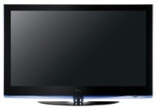
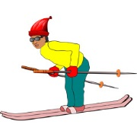





Tentative layout at the lecture room 1
reception
ゲーム後アンケート（読み上げ式）
ゲーム前アンケート
（読み上げ式）
ゲーム後アンケート（読み上げ式）

Slide 17
Requested staff number
所属（氏名） ＊敬称略 | 11th (10：00-15：00) Preliminary mtg. @ R&D Unit | 13th (13:00-16:00) Simulation @Health Promotion Center | 20th(9:30-17:00) Field Test @Health Promotion Center | 21st (9:30-13:00) Field Test @Health Promotion Center
Turku UAS (Teppo) | ○ | ○ | ○ | ○
健康福祉事業団（入江） | ○ | ○ | ○ | ○
健康福祉事業団（濱登） | ー | ○ | ○ | ○
仙台高専（ Ozaki ） | ー | ○ | ○ | ○
仙台高専（Ueda ） | ー | ○ | × | ○
仙台高専（Mayama ） | ― | ○ | × | ○
S-FWBC （平松） | ○ | ○ | ○ | ○
S-FWBC （ 佐々木 ） | ー | ○ | ○ | ○
S-FWBC （ 菊田 ） | ー | ○ | ○ | ー

Slide 18
Requested staff number
organization（Name） ＊dispense with the Mr. and Mrs. | 11th (10：00-15：00) Preliminary mtg. @ R&D Unit | 13th (13:00-16:00) Simulation @Health Promotion Center | 20th(9:30-17:00) Field Test @Health Promotion Center | 21st (9:30-13:00) Field Test @Health Promotion Center
Turku UAS (Teppo) | ○ | ○ | ○ | ○
S-HPC （Irie） | ○ | ○ | ○ | ○
S-HPC(Hamato） | ー | ○ | ○ | ○
S-NCT（ Ozaki ） | ー | ○ | ○ | ○
S-NCT（Ueda ） | ー | ○ | × | ○
S-NTC（Mayama ） | ― | ○ | × | ○
S-FWBC ( Hiramatsu） | ○ | ○ | ○ | ○
S-FWBC （Sasaki） | ー | ○ | ○ | ○
S-FWBC （ Kikuta ） | ー | ○ | ○ | ー

